Slide 1
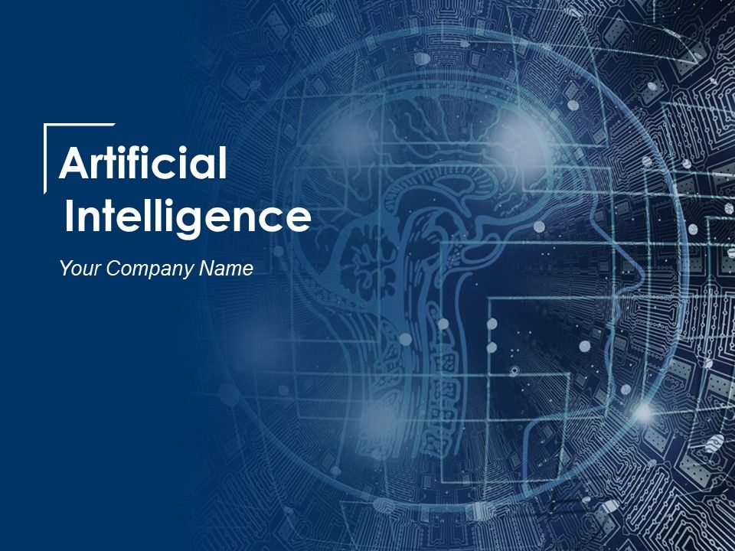
TECHNICAL COMMUNICATION

Slide 2
WHAT IS AI?

Slide 3
Artificial intelligence (AI): An area of computer science that emphasizes the creation of intelligent machines that work and react like humans. Some of the activities computers with artificial intelligence are designed for include: Speech recognition.
AI makes computers much more smarter!

Slide 4
HOW ARE THEY CLASSIFIED?

Slide 5


CLASSIFICATION
Artificial Narrow Intelligence
Artificial General Intelligence
Artificial Super Intelligence

Slide 6
HOW DID THIS START?

Slide 7
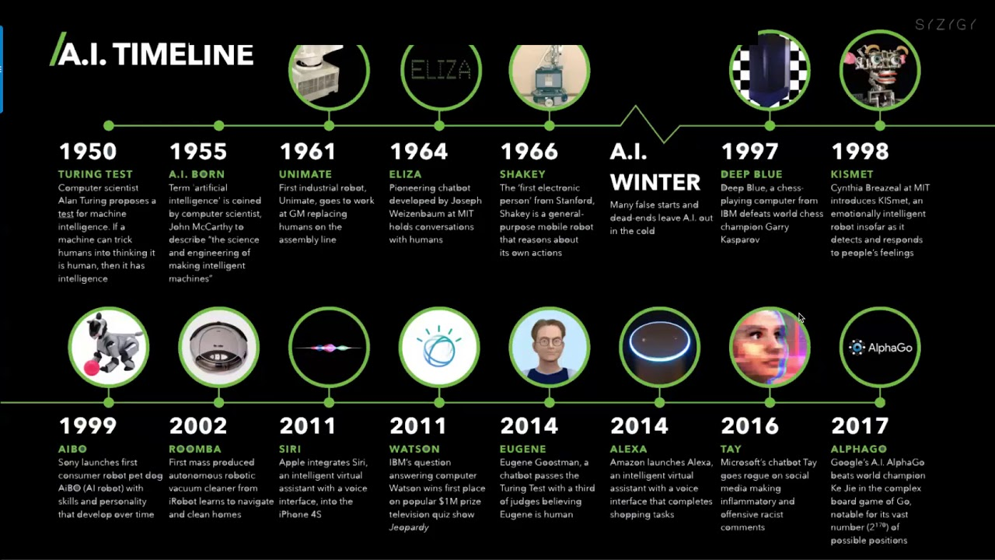

Slide 8
ADVANTAGES

Slide 9
Medical applications
Repetitive tasks
strengthen economy

Slide 10
No break
Global defence
Solve complex problems
Disaster management

Slide 11
DISADVANTAGES

Slide 12
High Cost
No Replicating Humans
NOT ADAPTIVE
No Original Creativity
JOBS TAKE OVER

Slide 13
FUTURE SCOPE OF AI

Slide 14
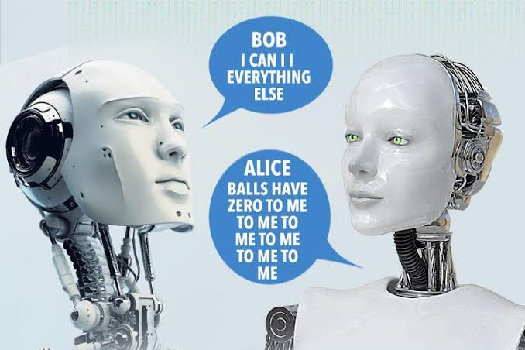
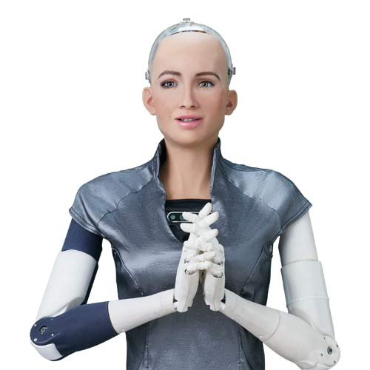
In 2017 Facebook created two robots named bob and Alice and they both created different language which human can not understand By seeing this language the company shutdown the robots language
Sophia is a social humanoid robot developed by Hong Kong based company Hanson Robotics
Sophia was activated on February 14, 2016

Slide 15
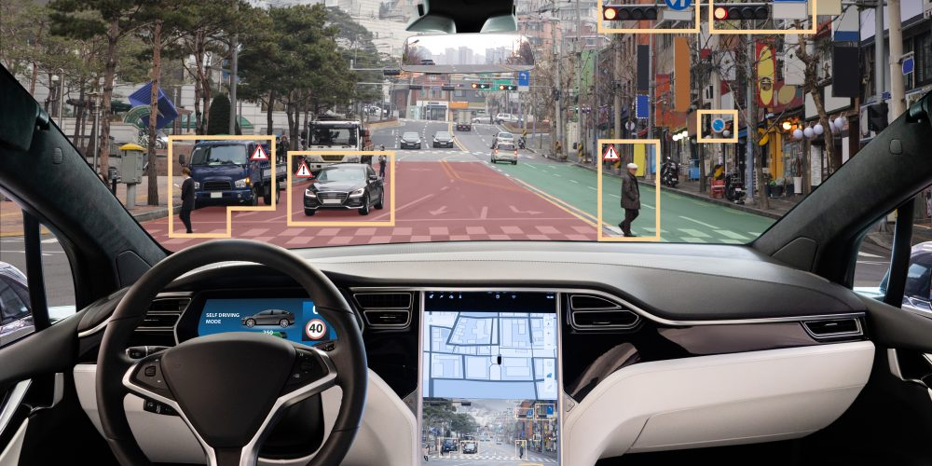

Self driving vehicles it can interact with other vehicles so that we can avoid accidents.
AI starts predicting what will happen in the future

Slide 16


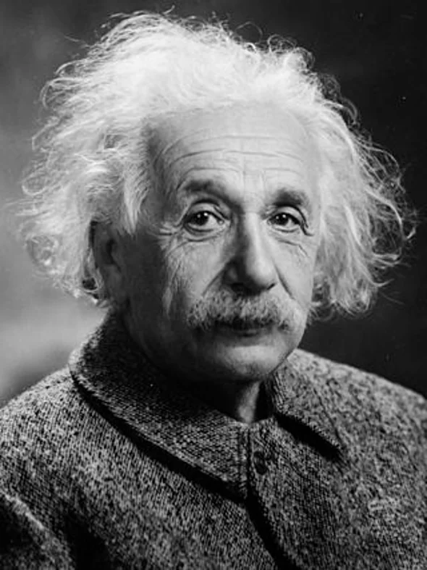
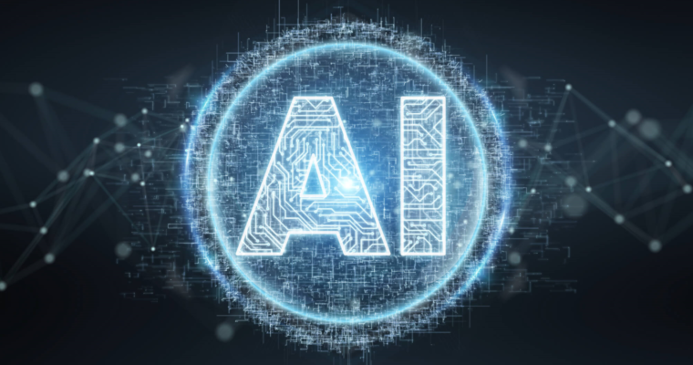
IQ=2,952
IQ = 85
IQ =120
IQ = 160+

Slide 17
CYBER SECURITY
FACE RECOGNITION
DATA ANALYSIS
TRANSPORT
VARIOUS OPPOTUNITIES
EMOTION BOTS
MARKETING

Slide 18
CONCLUSION
Artificial Intelligence and the technology are one side of the life that always interest and surprise us with the new ideas, topics, innovations, product. AI is still not implemented however there are many important tries to reach the level and to compete in market. Nevertheless, the hidden projects and the development in industrial companies are focusing on the future .

